Slide 1
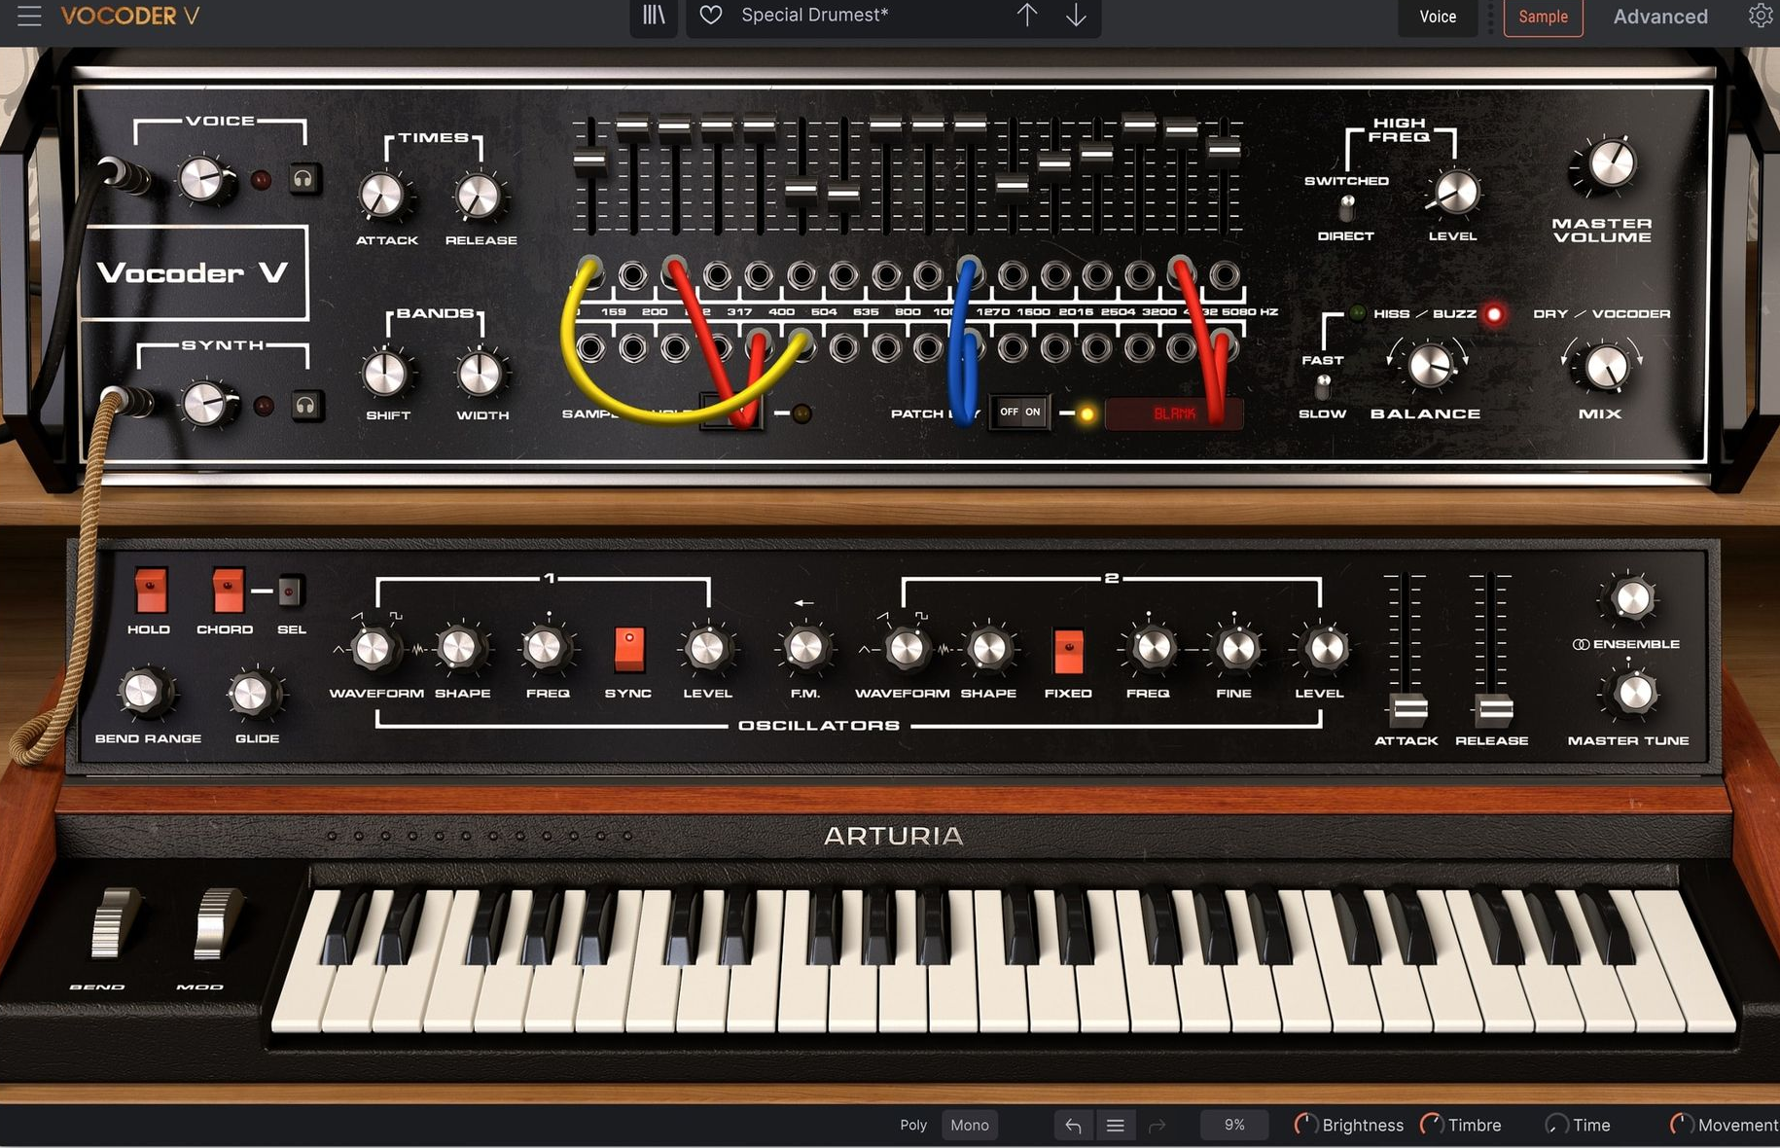
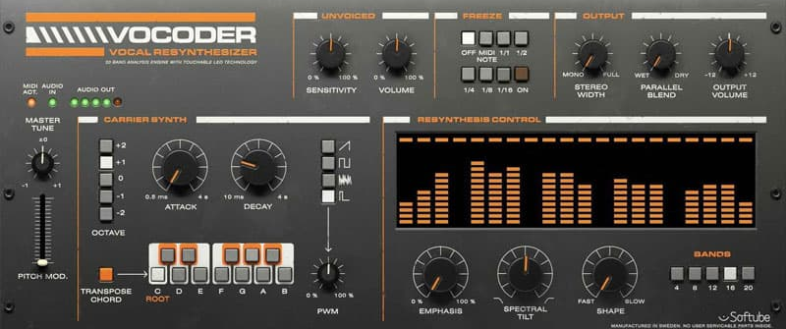
Channel Vocoder
DSP Final Project Coleman Jenkins

Slide 2
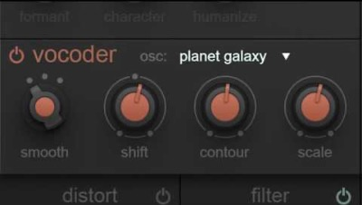
What is a Vocoder?
Audio effect that makes a wideband input signal sound like a human voice
Actually broader, but this is the main application

Slide 3
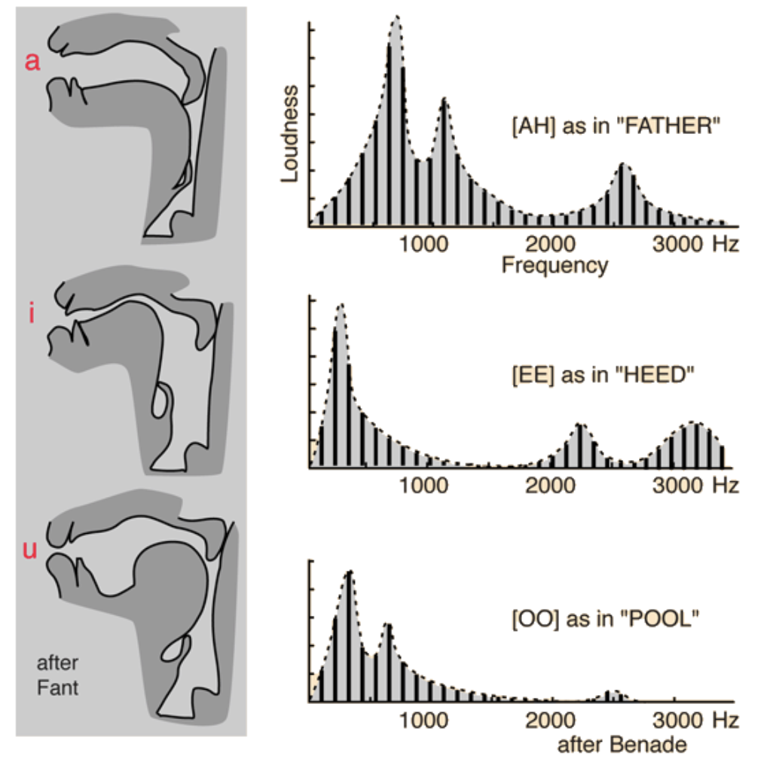
The Human Voice
Voice produces high frequency pulses
Vowel formants look like peaks at certain frequencies
Voice can be modeled as a wideband sound with changing amplitude band pass filters
Source: Luke S. Dahl; original here

Slide 4
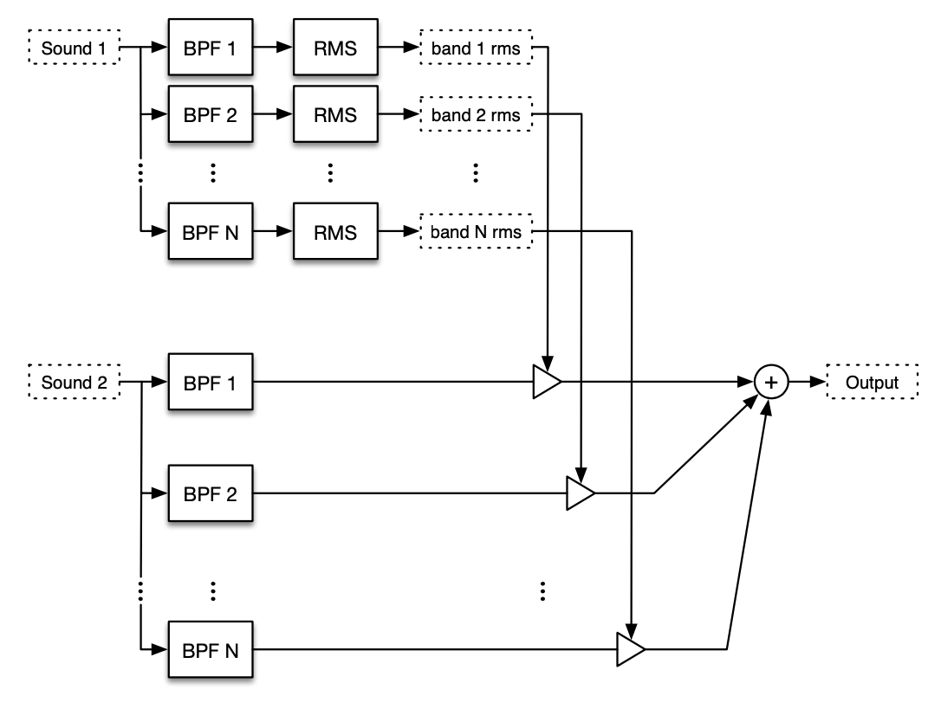
Vocoder Signal Diagram
Source: Luke S. Dahl

Slide 5
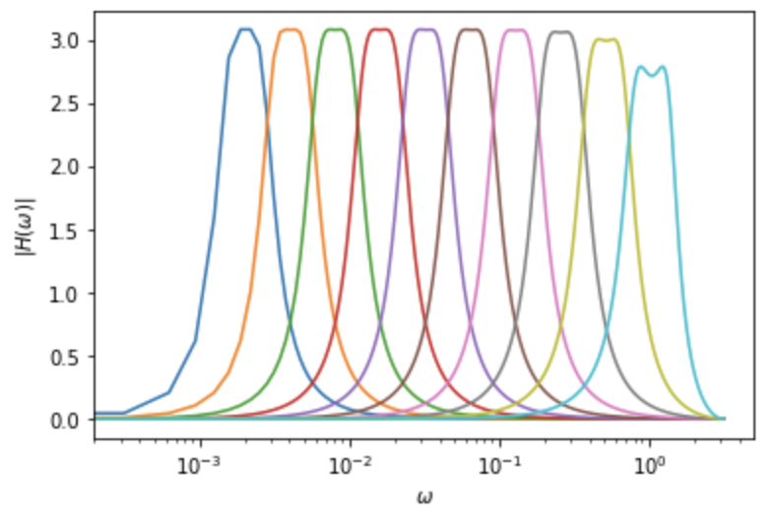
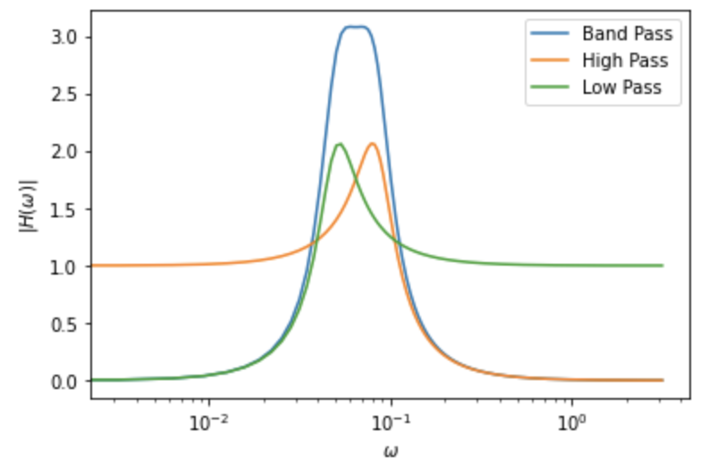
Vocoder Band Pass Filters
Composition of
Biquad High Pass Filter
Biquad Low Pass Filter
High Q in component filters for wider, flatter band
Magnitude is > 3
Normalized later by audio playback
For real time implementation, divide coefficients by max
# of bands is parameter

Slide 6
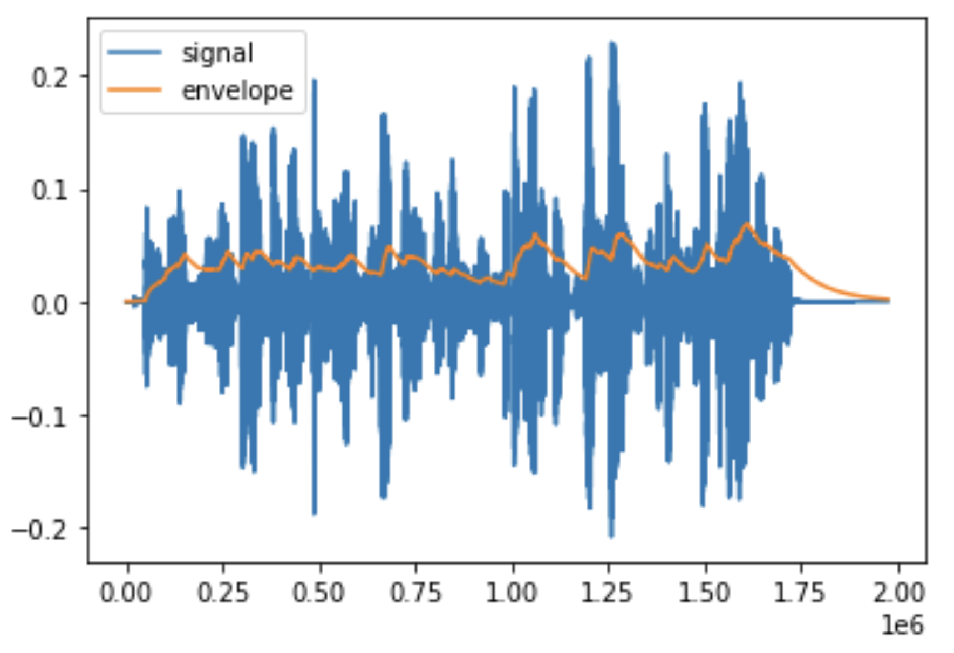




Envelope Follower*
$$y\left[n\right]=bx\left[n\right]+\left(1−b\right)y[n−1]$$
$$b=1−e^{\frac{1}{τf_{s}}}$$
$τ→$ decay time
*using RMS, so $x[n]→x^{2}$, and $y→\sqrt{y[n]}$

Slide 7

Results: Example 1
suzanne
synth
result

